Slide 1



SDG indicator 6.5.1
Implementing integrated water resources management (IWRM)
2023 monitoring and reporting overview
March 2023

Slide 2
Contents
Background: IWRM reporting in the context of the SDGs
Timeline, Help Desk and Monitoring Guide
SDG 6.5.1 Survey Overview
Stakeholder consultation process for 6.5.1 reporting
SDG 6 IWRM Support Programme
6.5.1 progress and the need to accelerate

Slide 3

SDG indicator 6.5.1: Implementing IWRM
2023 monitoring and reporting overview
Part 1
IWRM reporting in the context of the SDGs
March 2023
Notes:
Welcome to Part 1, which will present some background information on Integrated Water Resources Management reporting in the context of the sustainable development goals.

Slide 4
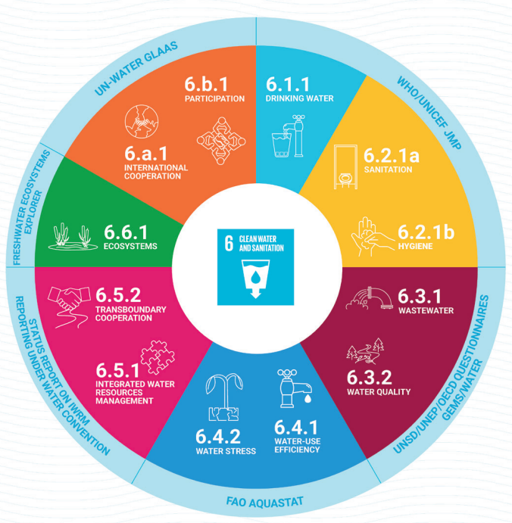

The 2030 Agenda and SDG 6
12 indicators, 8 targets measure progress towards SDG 6.
Notes:
The United Nations supports countries to monitor water- and sanitation-related issues within the framework of the 2030 Agenda for Sustainable Development – or SDGs. This effort is coordinated by UN-Water, through the Integrated Monitoring Initiative for SDG 6, also known as "IMI-SDG6".
In total, 12 indicators contribute to reporting on the progress towards SDG 6, with various UN organisations acting as custodian agencies for each indicator.

Slide 5

Sustainable Development Goal (SDG) 6
Ensure availability and sustainable management of water and sanitation for all
Target 6.5: By 2030, implement integrated water resources management at all levels, including through transboundary cooperation as appropriate.
Indicator 6.5.1: Degree of integrated water resources management (IWRM) implementation
Indicator 6.5.2: Proportion of transboundary basin area with an operational arrangement for water cooperation
The United Nations Environment Programme (UNEP) is the custodian agency for indicator 6.5.1
Notes:
SDG 6 is to "ensure availability and sustainable management of water and sanitation for all." But it covers much more than water supply and sanitation.
The goal covers all aspects of water resources management, and cuts across social, economic and environmental dimensions of sustainable development. Goal 6 is essential for meeting other goals, such as those on food and energy security, and biodiversity.
As you know, a key part of managing freshwater lies in understanding the different needs and roles of people who use that water – as well as the laws, institutions and governance mechanisms that are in place to manage it. These aspects are covered by the IWRM approach, which is the focus of target 6.5.
Target 6.5 is about ‘implementing’ IWRM, more than simply having a plan, so the stages of implementation, across various aspects of IWRM, must be monitored.
{CLICK} - Indicator 6.5.1 assesses the degree of IWRM implementation in each country. Indicator 6.5.2 specifically deals with transboundary cooperation. Data for 652 is collected in a separate process, though focal points for 651 and 652 should communicate with each other to harmonize reporting as far as possible.
{CLICK} UNEP is the custodian agency for indicator 6.5.1.

Slide 6
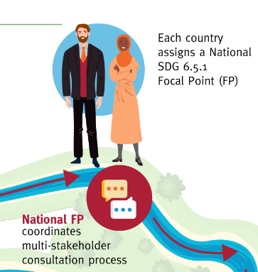

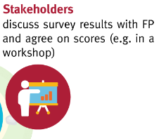
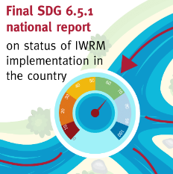
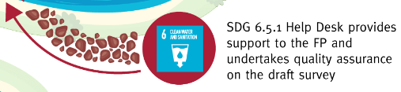

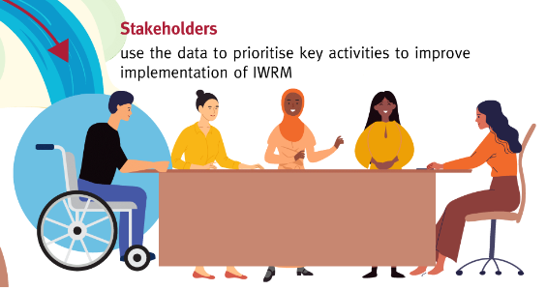

Notes:
The SDG 6.5.1 reporting process is laid out in this infographic.
{CLICK} The UN Environment Programme, as custodian of indicator 6.5.1, invites countries to undertake data collection.
{CLICK} Each country then assigns a National SDG 6.5.1 Focal Point, or FP. These national focal points are responsible for coordinating a multi-stakeholder consultation process to ensure broad engagement to complete the survey.
{CLICK} The stakeholders discuss the survey results and agree on the scores, for example in an in-person or online consultation.
{CLICK} The SDG 6.5.1 Help Desk is available throughout the process to provide support to the Focal Points and undertake quality assurance of the draft survey results.
{CLICK} The final SDG 6.5.1 national report on the status of IWRM implementation in the country is published.
{CLICK} The UN Statistics Division receives the results from UNEP,
{CLICK} UNEP produces a global analysis and report and shares these on the IWRM Data Portal,,
{CLICK} and stakeholders can then use the data to prioritise key activities to improve implementation of IWRM.

Slide 7

SDG indicator 6.5.1: Implementing IWRM
2023 monitoring and reporting overview
Part 2
Timeline, Help Desk, Monitoring Guide
March 2023
Notes:
Welcome to Part 2, which highlights the timeline for the 2023 round of reporting for SDG indicator 6.5.1, and introduces the Help Desk and the Monitoring Guide.​

Slide 8
Timeline for reporting 2023
February – March
Countries confirm
6.5.1 Focal Points
April - September
Mid-April: Roll-out survey and supporting material
1 October.
Submission of ‘final draft’
to UNEP
October – November
Quality assurance and finalization
December
All country submissions finalised
*Submission to UN Statistics Division in early 2024
See Monitoring Guide section 6
Notes:
The timeline for the reporting process for 2023 is laid out here.
During February and March, the SDG 651 Help Desk contacted countries to ask them to confirm their national focal points.
In Mid-April, the official survey and supporting materials is rolled out. Countries have approximately five months to complete the survey. During this period, the Focal Points are responsible for leading a multi-stakeholder consultation process to develop the national report for 2023.
The final draft of the survey should be submitted to the Help Desk by the 1st of October 2023.
During October and November, the Help Desk will conduct a standard quality assurance before agreeing with the focal points on the final version of the national survey.
UNEP will then submit the final reports to the UN Statistics Division in early 2024, for annual global status reporting across the SDGs.

Slide 9

SDG 6.5.1 Help Desk
Any questions related to 6.5.1 reporting
Quality Assurance(QA): "interim" draft reports are encouraged, and feedback will be provided to complete your draft submission.
Submit final drafts to the Help Desk
Questions about the SDG 6 IWRM Support Programme
iwrmsdg651@un.org.
Notes:
SDG indicator 6.5.1 provides support to all national Focal Points in their data collection efforts via a dedicated mailbox, called the Help Desk. The Help Desk can support with:
{CLICK} - Any questions relating to the reporting process ,
{CLICK} - Quality Assurance: Focal Points are encouraged to share “Interim Drafts” with the Help Desk for informal feedback and clarifications.
{CLICK} The complete final draft survey should be submitted by Focal Points to the Help Desk, who will undertake standard QA procedures to check that the survey has been properly completed, with correct calculation of indicator scores.
{CLICK} - Finally, the Help Desk can assist with country requests for support from the SDG 6 IWRM Support Programme

Slide 10
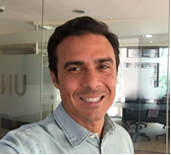


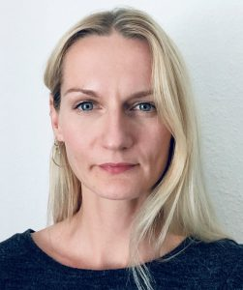
SDG 6.5.1 Help Desk
Julian Serafin
Lisbet R Hansen
Paul Glennie
Maija Bertule
Focal Points are encouraged to reach out to the Help Desk team:
iwrmsdg651@un.org
Notes:
The Help Desk team, based at UNEP – the custodian agency for indicator 6.5.1 - is ready to support you in all UN languages: English, French, Spanish, Arabic, Russian and Chinese, as well as Portuguese.

Slide 11
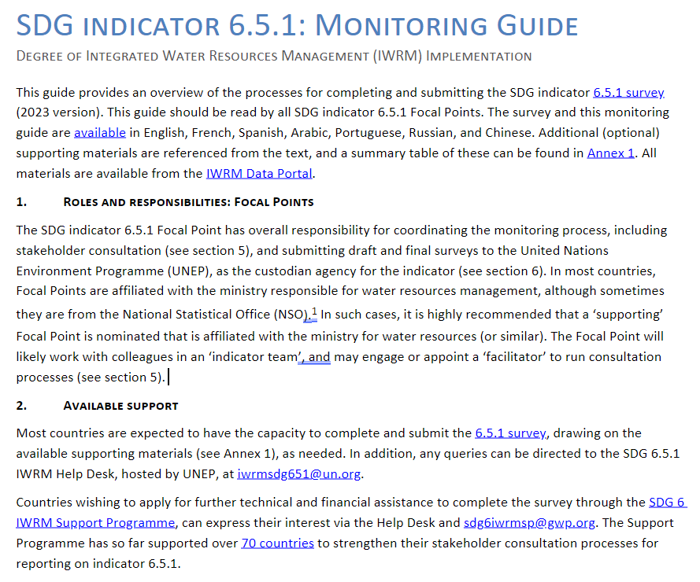
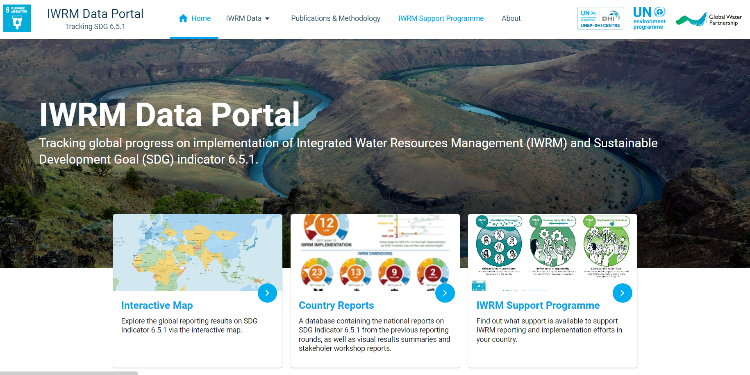
Monitoring Guide
IWRM Data Portal
http://iwrmdataportal.unepdhi.org/
MUST READ
Notes:
The primary supporting material is the indicator 6.5.1 Monitoring Guide.
It provides an overview of the entire reporting process and is a must-read for all Focal Points and their teams. It is only 3 pages long, with two pages of annexes.
All other Supporting Materials are ‘optional’, based on the needs of each country, and are listed in the Annex of the Monitoring Guide.
{CLICK} - All supporting materials, previous reports and resources related to SDG 6.5.1, can be found on the IWRM Data Portal.

Slide 12
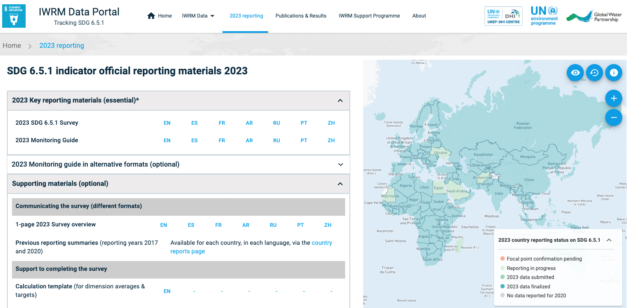
Notes:
The survey, monitoring guide and supporting documents can be downloaded directly from the IWRM Data Portal.

Slide 13

SDG indicator 6.5.1: Implementing IWRM
2023 monitoring and reporting overview
Part 3
SDG 6.5.1 Survey
March 2023
Notes:
Welcome to part 3. This video will take a closer look at the survey, which is the mechanism for reporting on SDG indicator 6.5.1.

Slide 14
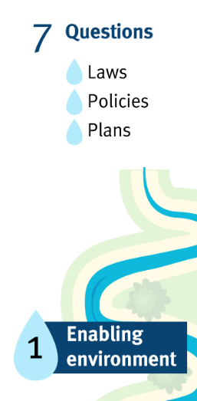
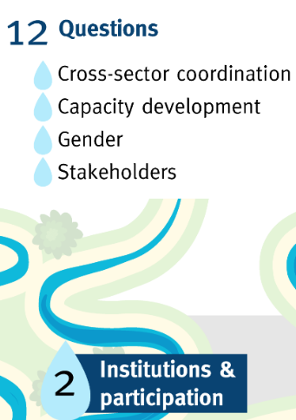
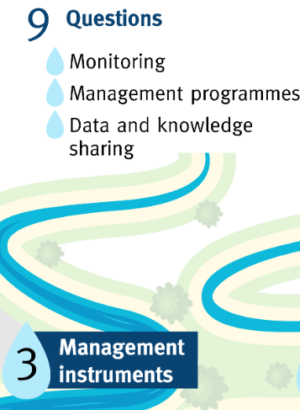
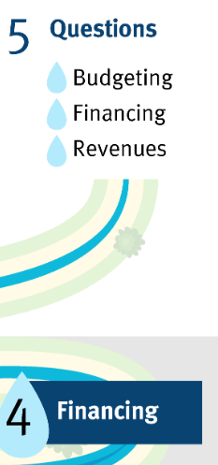
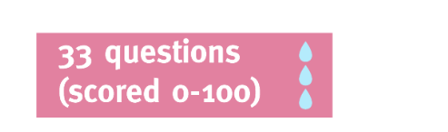
SDG Indicator 6.5.1 Survey Overview
Notes:
The left-hand side of this infographic shows a schematic of the SDG indicator 6.5.1 survey, and the right-hand shows how the scores are calculated.
The survey has 33 questions, split into 4 sections, which reflect the 4 main dimensions of IWRM. The four sections are:
{CLICK} One, the enabling environment, covering the main policies, laws and plans.
{CLICK} Two, covering institutional capacity and coordination, and stakeholder participation.
{CLICK} Three, covering the management instruments that support effective decision-making.
{CLICK} And four, covering financing, budgeting and revenue raising.
On the right-hand side, we see an explanation of the scoring methodology.
{CLICK} Each question receives a score out of 100.
{CLICK} The 4 dimension averages are calculated by averaging the question scores for each section.
{CLICK} And the final indicator score is calculated by averaging the 4 dimension scores.

Slide 15
How to respond to the survey questions
Build on 2017 & 2020 reporting
Give scores in increments of 10, from 0 – 100
(i.e. 0, 10, 20, 30, 40, 50, 60, 70, 80, 90, or 100).
6 threshold descriptions to guide scoring (each question).
Complete free-text fields: ‘Status and progress’ and ‘Way forward’ (each question).
Respond to all questions (no blanks).
Pay close attention to all explanatory text and footnotes.
Notes:
Here are some key considerations to include when completing the survey:
Build on 2017 & 2020 reporting from your country
For each question, responses can be given in increments of 10, from 0 to 100.
There are six threshold descriptions to guide your responses to each question.
We strongly encourage you to spend some time on the free text fields after each question.
All questions should be answered. It is possible to answer ‘not applicable’ to some questions, such as transboundary level questions, if your country has no transboundary freshwater.
{CLICK} - And please pay close attention to all of the explanatory text and footnotes throughout the survey.

Slide 16
Survey question example
Section (1-4)
Sub-section (1.1, 1.2 etc.)
Thresholds and descriptions
Question (a, b, c, etc.)
1. Enabling Environment
 |  | Degree of implementation (0 – 100)
 |  | Very low (0) | Low (20) | Medium-low (40) | Medium-high (60) | High (80) | Very high (100)
1.1 What is the status of policies, laws and plans to support Integrated Water Resources Management (IWRM) at the national level?
a. National water resources policy, or similar. |  | Development not started or not progressing. | Exists, but not based on IWRM. | Based on IWRM, approved by government and starting to be used by authorities to guide work. | Based on IWRM, being used by the majority of relevant authorities to guide work. | Policy objectives consistently achieved. | Objectives consistently achieved, and periodically reviewed and revised.
Score | XX
Status and progress: xxx [E.g. policy(ies), key years, examples of how the policy is being used to guide work, and which policy objectives are monitored/achieved. Consider progress since previous reporting rounds .]
Way forward: xxx [E.g. planned or recommended activities to advance implementation of policies; barriers and enablers; draft interim targets where appropriate.]
Enter score in increments of 10 (or n/a)
Enter free text in ‘Status and progress' and ‘Way forward’ fields.
Helps: reach consensus in country; track progress over time; objectivity.
Notes:
Let's take a closer look at the survey questions. Here’s a simplified example of one of the questions.
{CLICK} Firstly, at the top left we have the section number and heading.
{CLICK} Below this, we have the sub-section heading, which is phrased as a question and guides all the questions within the sub-section.
{CLICK} Below this we have the question itself, identified by consecutive lettering. So this question is referred to as 1.1a.
{CLICK} To the right of the question, the thresholds and threshold descriptions are given for the scores of zero, 20, 40, 60, 80 and 100, and these are categorised from ‘very low’ to ‘very high’ implementation. If your country is between these thresholds, simply select the increment of 10 between them, so 10, 30, 50, 70 or 90.
{CLICK} You enter the score, in increments of 10, in the yellow cell. If the question is not applicable for your country, you can enter ‘n/a’.
{CLICK} Below the score is a very important aspect of the survey. The ‘status and progress’ and 'way forward' fields allow you to provide the context for the score and to highlight potential barriers and enablers to advancing that aspect of IWRM. You should also reflect on the progress since previous reporting rounds. The text you provide in these fields should help you reach consensus among stakeholders on the score, and help you track progress over time. It also increases the objectivity and transparency of the score, because it becomes evidence-based.

Slide 17
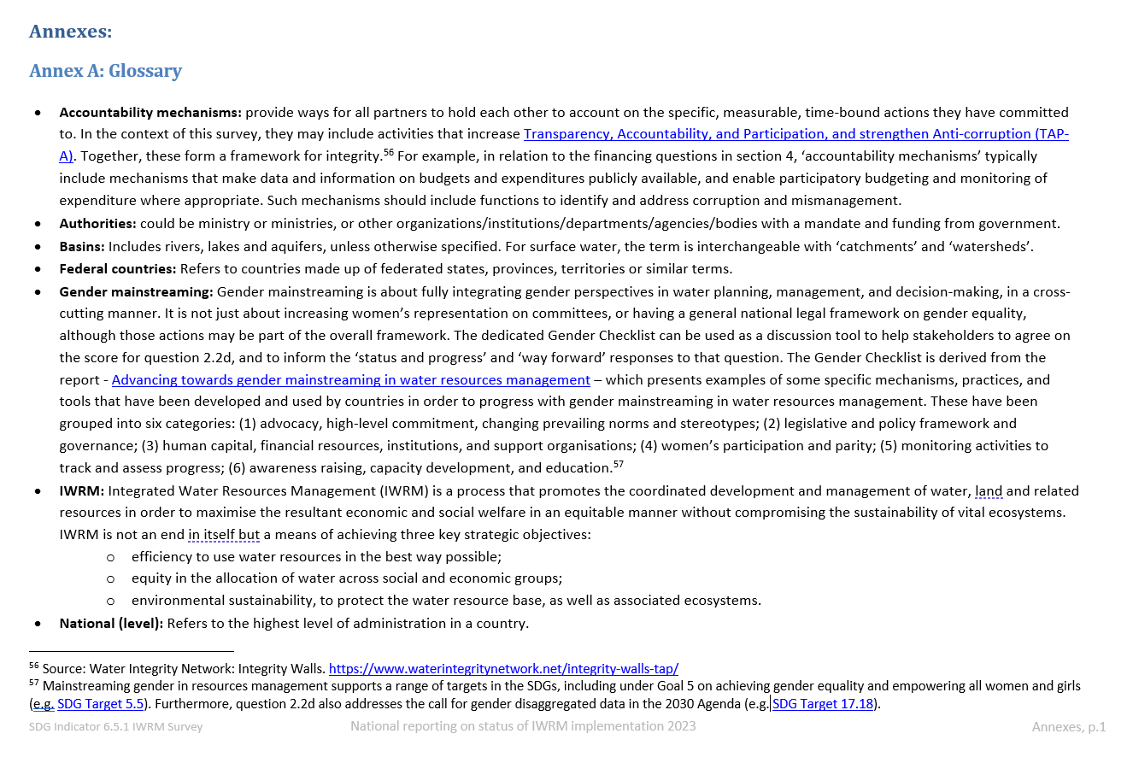
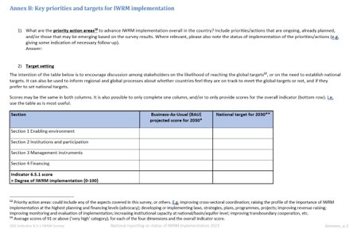
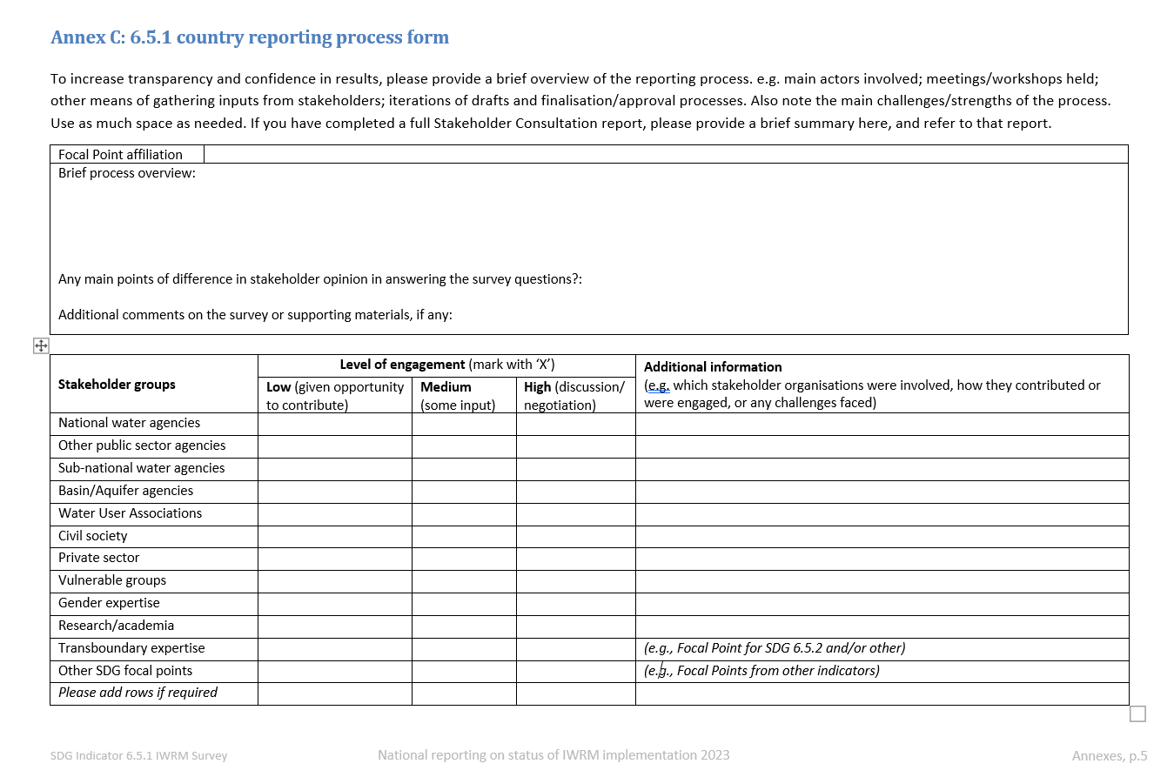
Annexes
A: Glossary
B: Key priorities and targets for IWRM
implementation
C: Country reporting process form
  To improve transparency in reporting
Notes:
The survey also has three short annexes, which are designed to make the survey instrument more useful and robust at national, regional and global levels.
These are
CLICK Annex A – Glossary,
CLICK Annex B – Key Priorities and Targets for IWRM implementation,
CLICK - and Annex C – Country reporting process.
We strongly encourage you to complete annexes B and C.

Slide 18
Key changes from 2020 survey
Fewer annexes (from 5 to 3)
Target-setting introduced (Annex B)
Climate change considerations strengthened: dedicated free-text fields for 5 questions
More explicit links to other SDG 6 indicators
Accountability mechanisms included
New "Gender Checklist" (supporting materials)
Notes:
Some of the key changes you will notice in the 2023 survey include :
Two annexes have been removed: the transboundary annex and the priority water resources challenges annex.
The opportunity to discuss country targets has been introduced in Annex B.
Climate change aspects have been strengthened, through additional dedicated free-text fields for 5 questions.
More explicit links to other SDG 6 indicators have been included.
Accountability mechanisms have been included in some of the question thresholds. These cover aspects such as Integrity, transparency, accountability, participation, and anti-corruption.
Gender aspects have been strengthened. A "Gender Checklist" has been added as one of the supporting materials.

Slide 19
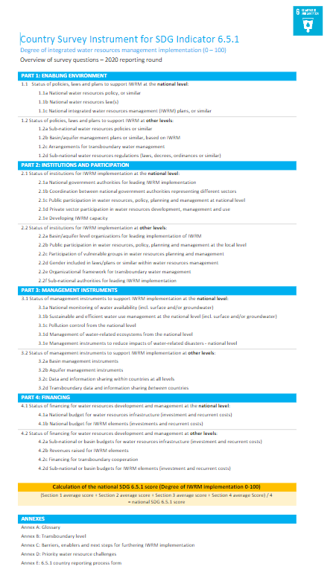
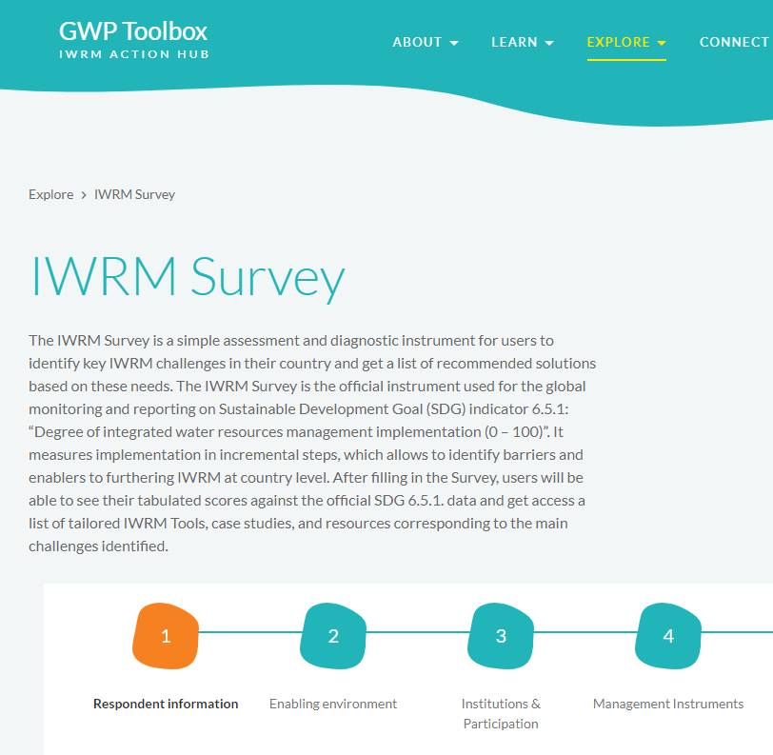
Support for completing the survey
Primary guidance within Survey and Monitoring Guide.
Additional Supporting Materials:
Survey overview
Calculation template
Gender checklist
Online IWRM Survey tool (optional)
Notes:
The main guidance for completing the survey can be found within the Survey itself and the Monitoring Guide.
{CLICK} Additional supporting materials, which are optional, include:
{CLICK} The survey overview. This is a one page summary, which can be useful to get an overview, especially to communicate the survey with stakeholders, as the survey document is quite long.
{CLICK} The calculation template is a simple Excel file to support the correct calculation of dimension and indicator scores. It can also support to completing the table on targets in Annex B.
{CLICK} The Gender Checklist is there to support discussion on survey question 2.2d, on the status of gender mainstreaming in water resources management.
{CLICK} This year you can also use the new online survey tool, which is covered in the next video.

Slide 20
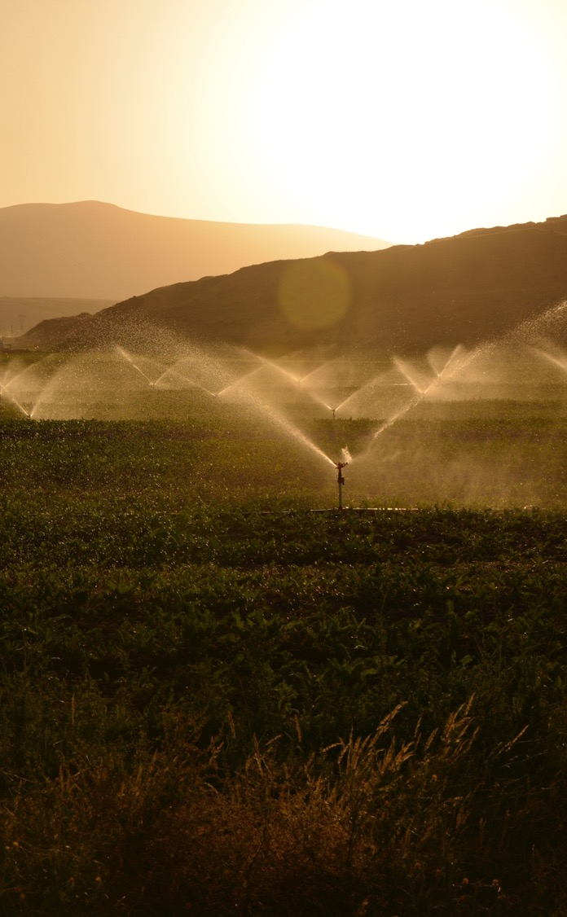
SDG indicator 6.5.1: Implementing IWRM
2023 monitoring and reporting overview
Part 4
Stakeholder Consultation Processes for 6.5.1 reporting
See also: Monitoring Guide ; Stakeholder Consultation Manual
March 2023
Notes:
Welcome to part 4. This video will introduce the stakeholder consultation process for SDG indicator 6.5.1 reporting

Slide 21
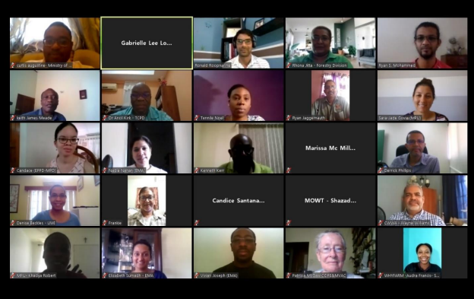
Stakeholder Consultations
Why?
  More robust and accurate reporting
  Shared understanding of key priorities
  Useful national instrument for IWRM planning and implementation
Responsibility: National SDG 6.5.1 Focal Point leads process
(supported by team, potentially including a facilitator)
Considerations:
  Stakeholder types: who and how?
  Sequencing: series/parallel/mix
  Formats: in-person/online/hybrid
  Best practices
Notes:
The main aim of the stakeholder consultation process is to make the survey a more robust and useful national instrument for IWRM planning and implementation. This supports efforts for working towards Target 6.5.
{CLICK} The national Focal Point coordinates inputs from colleagues and other stakeholders to complete the survey. Focal Points are responsible for planning and managing a process that is appropriate in the national context.
{CLICK} - In the next four slides, we’ll touch on four considerations in planning the consultations. These are:
Potential stakeholder groups,
Options for sequencing your engagement with them,
Different formats for stakeholder consultation,
And some best practices in stakeholder consultation.

Slide 22
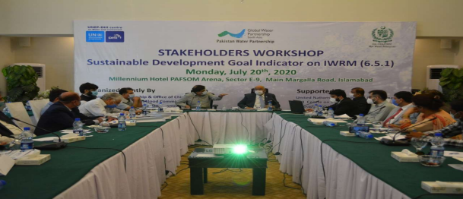
i. Potential stakeholder groups
Government authorities (across sectors and levels)
Basin and aquifer level organisations
Other groups: community groups, water user associations, private sector, NGOs, environmental organizations, water resources management practitioners, academia
Other SDG focal points
Consider representation / expertise on
vulnerable groups and gender.
Aim to be as consultative as possible,
considering budget, time, resources.
Notes:
Potential stakeholder groups will include authorities from within the main ministry responsible for water resources, as well as those from other ministries, such as agriculture, energy, environment, and finance. This may include national through to lower levels of government.
{CLICK} Basin and aquifer level organisations are clearly important in the context of water and land management.
{CLICK} And there will be a number of other stakeholder groups which we encourage you to reach out to.
Some stakeholder groups may have inputs to all questions, while others may only have inputs to certain questions.
{CLICK} The aim is to be as consultative as you can be, considering resources and time available.

Slide 23
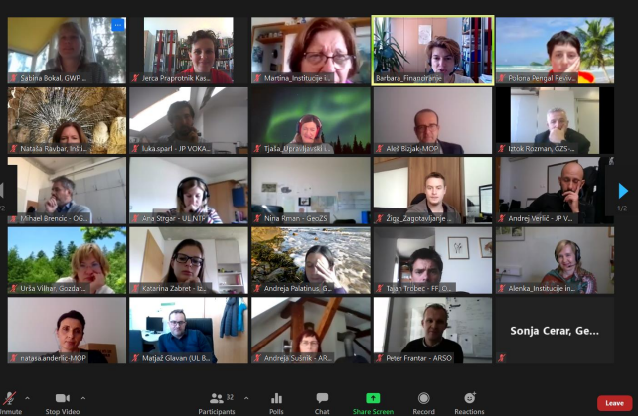
ii. Sequencing
consecutive drafts developed with different stakeholder groups.
Series approach:
Parallel approach:
Combination of both.
different stakeholder groups fill out blank survey, responses analysed by Focal Point, then consensus reached on scores.
Final sign-off at national level, before submission.
Notes:
Broadly speaking, there are two approaches to developing a consolidated survey, but you’re likely to use a combination of both.
{CLICK} In the series approach, consecutive drafts can be developed with different stakeholder groups, and the drafts are refined each time based on stakeholder inputs.
{CLICK} In the parallel approach, you can get different stakeholder groups to fill out a blank survey, and then analyse the responses. Then you can bring stakeholder groups together to reach consensus.
{CLICK} And as a final step you should of course follow your national procedures for official sign-off before final submission.

Slide 24
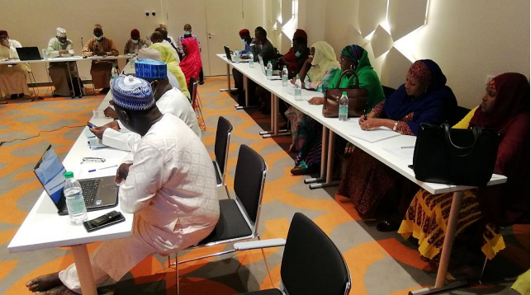
iii. Engagement formats
Online IWRM Survey tool
Optional tool that can be used by Focal Points to collect stakeholder inputs prior to consultations.
The tool can be shared with stakeholders in advance of consultations and inputs will be sent directly to the FPs.
The online tool is not a replacement for the official country submission (MS Word format).
LINK
In-person consultations
Online consultations
Hybrid
Other: email / phone / webinars
Consider: budget, time, resources
Notes:
The extent and means of stakeholder engagement is up to you. These can be in-person consultations, online consultations, or a hybrid mixture of both. Other options could include consultations via email, phone or a dedicated webinar.
{CLICK} These considerations all need to take into account your available resources and time.
{CLICK} For the 2023 reporting round, there is a new online survey tool available. The online survey can be shared with relevant stakeholders in advance of the consultation with the results sent directly to the national focal point. The online survey tool cannot be used for official submission of the survey, as this should be done in Microsoft Word format. There is more information on how to use the online survey tool in the Stakeholder Consultation Manual.

Slide 25

iv. Best practices
Inclusion
Procedural fairness
Agreement by consensus
Transparency
See Stakeholder Consultation Manual
Notes:
Finally, here are some best practices that you should consider when planning your national stakeholder consultations
{CLICK} - Inclusion - A broad range of stakeholders should be invited to take part in the consultations,
{CLICK} - Procedural fairness – Ensure that all participants are given space and time to voice their opinion in the consultation.
{CLICK} - Agreement by consensus - it is important that everyone is given the opportunity to speak, offer criticism, and bring new arguments or information into discussions in a conducive environment
{CLICK} - Transparency - Information should be made publicly available and should allow all relevant stakeholders to have access to information before the consultation, as well as access to a detailed account of the discussions held and results agreed.
For more information and tips, make sure to read the supporting material ”Stakeholder Consultation Manual".

Slide 26
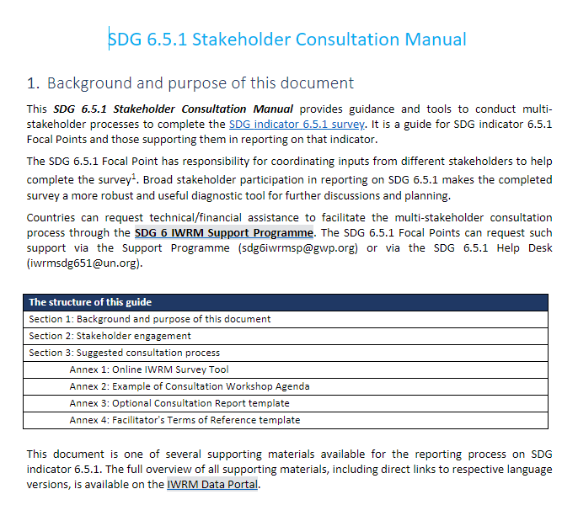
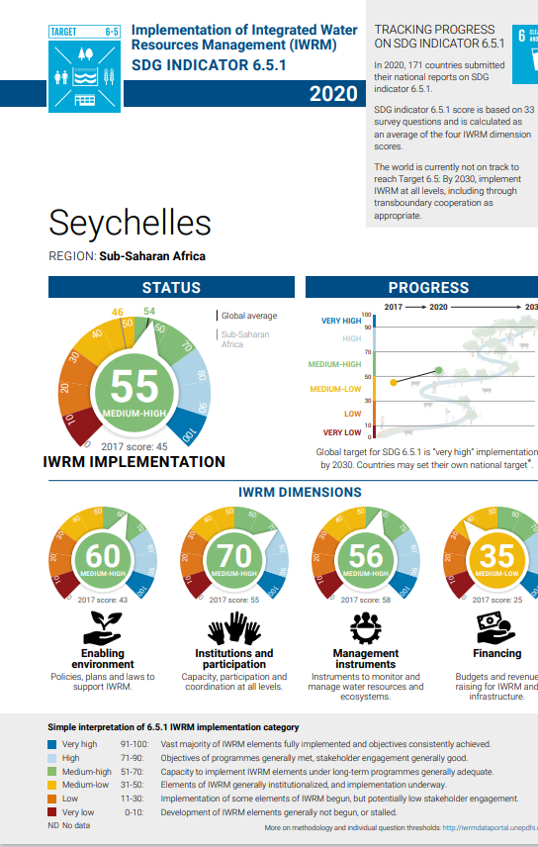
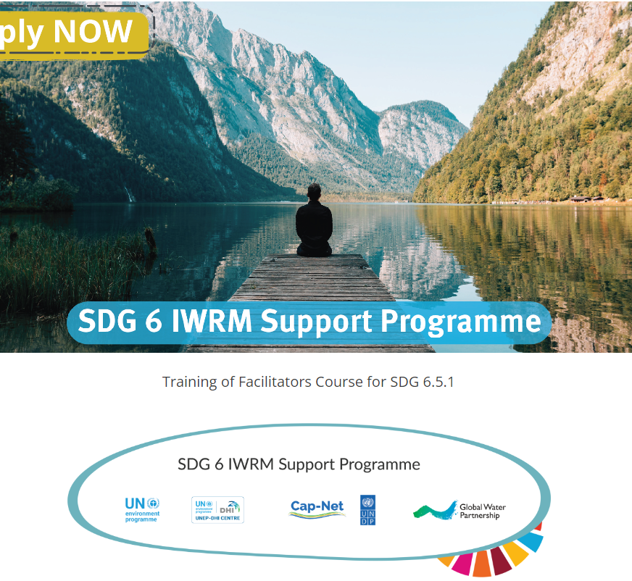
Optional supporting materials for stakeholder consultations
In addition to the Monitoring Guide:
Stakeholder Consultation Manual
Country results summary (2 pager)
Facilitators training course
(EN/FR/ES)
Support Package
(technical / financial support)
Notes:
There are several optional supporting materials available for the stakeholder consultation process, in addition to the Monitoring Guide.
{CLICK} The Stakeholder Consultation Manual provides further information and guidance on suggested stakeholder consultation processes. It also includes annexes covering: tthe online IWRM Survey Tool; an example workshop agenda; an optional consultation reporting template; and example Terms of reference for a facilitator.
{CLICK} The country results summaries are 2-page visual summaries of results from 2017 and 2020 per country, available for download in multiple languages from the IWRM Data Portal.
{CLICK} The Facilitator's Training Course is an optional self-paced, free, online course, with an expected commitment of 4-6 hours, available in English, French or Spanish . The course is available to anyone interested in organising a multi-stakeholder consultation process on SDG indicator 6.5.1 and helps them to fully understand what that indicator is, how it is calculated, as well as both the importance of involving multiple stakeholders and the practical means of doing so.
{CLICK} Finally, the Support Package is available on request, for those countries receiving technical/financial support through the SDG 6 IWRM Support Programme , which we’ll explain in the next video.

Slide 27

SDG indicator 6.5.1: Implementing IWRM
2023 monitoring and reporting overview
Part 5
SDG 6 IWRM
Support Programme
www.gwp.org/en/sdg6support/
March 2023
Notes:
Welcome to part 5. This video will present the SDG 6 IWRM Support Programme. You can find out further information by visiting the dedicated website shown on this slide.

Slide 28
Notes:
The SDG 6 IWRM Support Programme offers assistance to countries in reporting on SDG indicator 6.5.1 as an entry point to accelerate progress towards the achievement of water-related SDGs and other development goals, in line with national priorities. The Support Programme is coordinated by Global Water Partnership (GWP) in collaboration with UNEP-DHI Centre and Cap-Net, under the guidance of UNEP.
The Support Programme has three stages:
Stage 1: Identifying challenges
Stage 2: Developing Action Plans, and
Stage 3: Implementing Solutions
More information on each of the stages will be presented in the next slides.
For the 2023 reporting round of indicator 6.5.1, support is available for up to 60 countries for Stage 1.

Slide 29
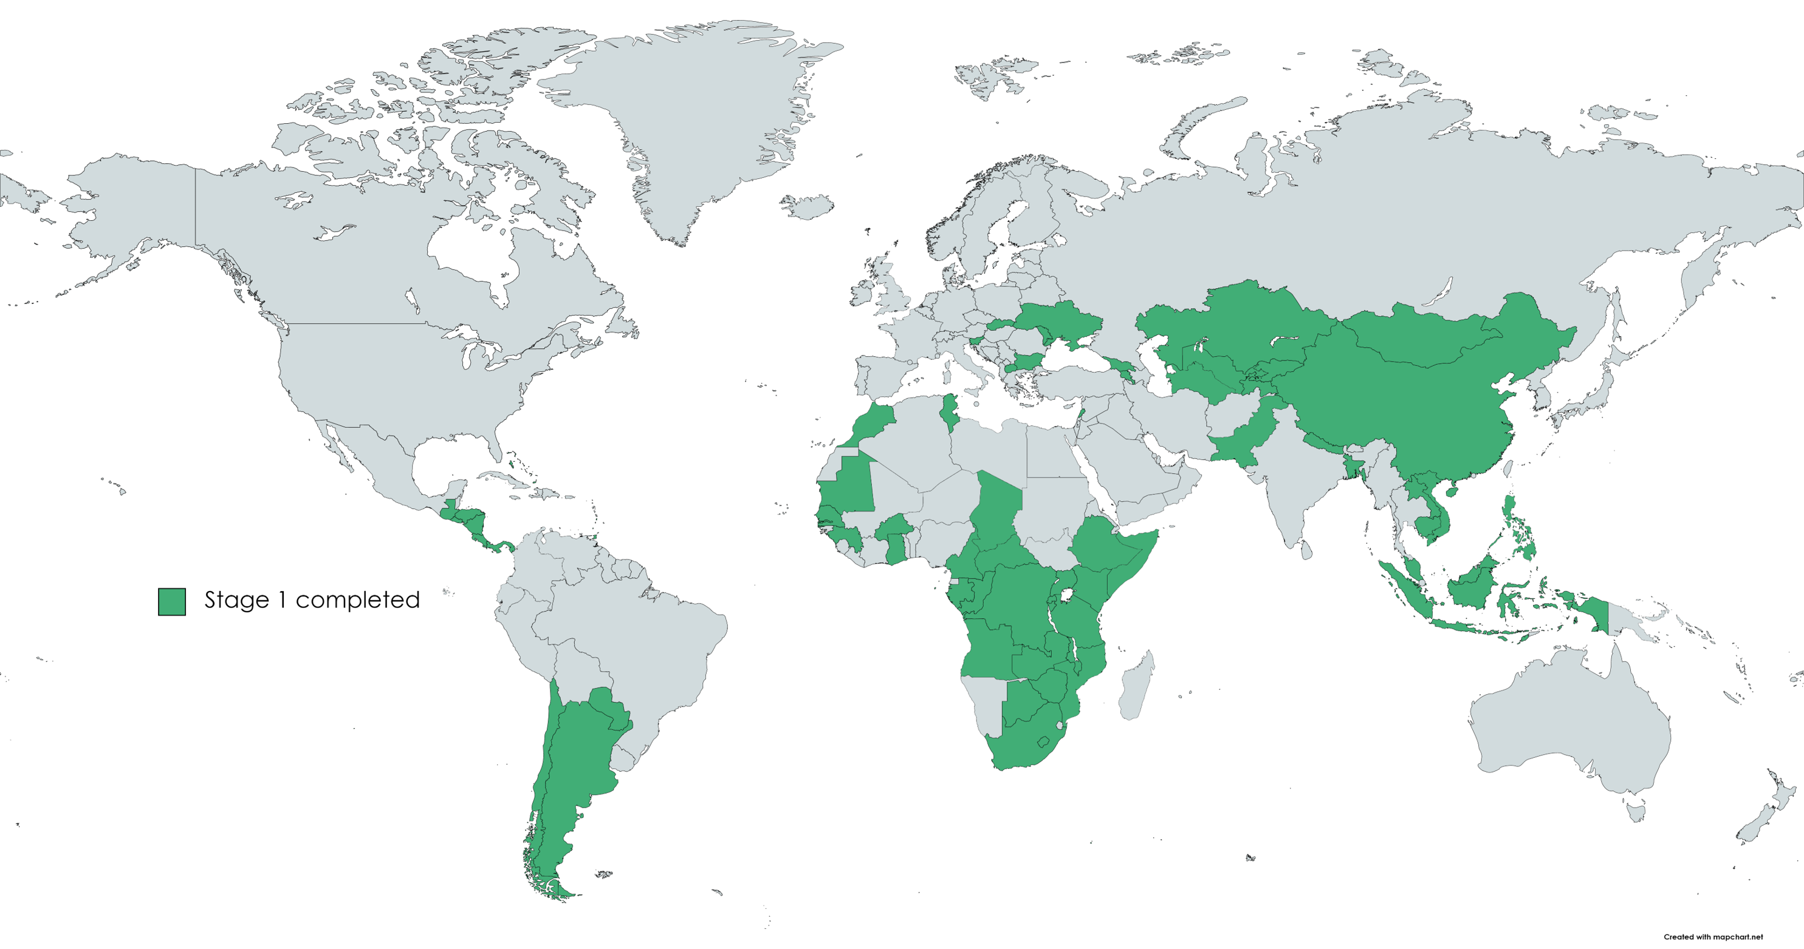
Stage 1: strengthening stakeholder consultation in 6.5.1 reporting
>70 countries supported in 2017 & 2020.
>3,000 stakeholders engaged
Notes:
The aim of Stage 1 of the SDG 6 IWRM Support Programme is to strengthen IWRM monitoring and reporting nationally, in order to identify critical areas for attention.
Under Stage 1, the Support Programme has assisted the SDG reporting process in more than 70 countries so far, across the 2017 and 2020 reporting rounds. More than 3000 stakeholders were engaged during the process.
The support is provided by the Global Water Partnership (GWP), through its Regional Water Partnerships (RWPs) and Country Water Partnerships (CWPs), who work hand-in-hand with the national SDG 6.5.1 Focal Point in the countries.

Slide 30
Stage 1: Partnership approach to identify challenges
Support available
Financial assistance:
to engage ‘Facilitator’, conduct consultations (60 countries)
Technical guidance:
open source, available to all countries (e.g. Support Package)
Selection criteria
Country commitment
Country co-financing (if feasible)
IWRM status
Find out more, email: sdg6iwrmsp@gwp.org
www.gwp.org/en/sdg6support/consultations/where-we-are/stage-1-activities/
Notes:
Two types of support are available to countries under Stage 1:
{CLICK} Financial assistance, where a Facilitator is engaged and support is provided to conduct consultations. This is available for up to 60 countries, upon request.
{CLICK} The selection criteria for financial assistance include country commitment to engage, country co-financing where feasible, and consideration of the country's IWRM status – based on scores from previous indicator 6.5.1 reporting rounds in 2017 and 2020.
{CLICK} The technical guidance consists of many of the supporting materials discussed in previous videos. For example, this includes a Support Package, which provides much more detailed guidance and tools for facilitating multi-stakeholder consultation processes for the completion of the SDG 6.5.1 survey. Further support is provided through an online training for facilitators course, in English, French and Spanish.

Slide 31
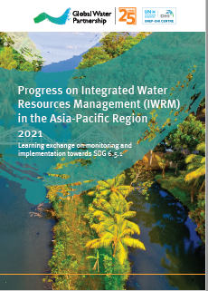
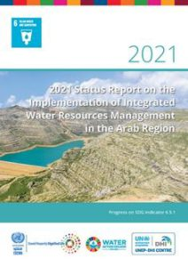
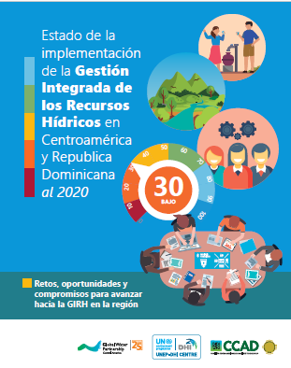
Regional learning exchanges
Objectives:
Share lessons from consultation process between focal points
Identify common challenges and opportunities to advance IWRM implementation at regional level
(with the possibility of leading to the production of regional reports, after national reporting)
Assistance available: SDG 6 IWRM Support Programme:
Facilitation support, technical guidance (through global teams, GWP Regional Water Partnerships, Country Water Partnerships)
Use of online tools including communities of practice
No financial support available
Notes:
Regional learning exchanges can be organized through the SDG 6 IWRM Support Programme.
{CLICK} The objectives of these exchanges are to share lessons learned from consultations between focal points, identify common challenges and opportunities, and advance regional level reporting.
{CLICK} The Support Programme can provide facilitation support and technical guidance, as well as online tools including communities of practice. No financial support is available for regional learning exchanges.

Slide 32
Stage 2: Formulating responses
Government-led multi-stakeholder process to formulate and prioritise responses to IWRM challenges.
Develop an IWRM Action Plan (or similar)
Only countries that have received Stage 1 support are eligible for Stage 2 from 2024 onwards.
https://www.gwp.org/en/sdg6support/consultations/where-we-need-to-go/stage-2-activities/
Notes:
Stage 2 of the Support Programme targets formulating responses.
{CLICK} Using the key challenges to IWRM implementation identified during Stage 1, Stage 2 aims to facilitate a government-led multi-stakeholder process to formulate and prioritise appropriate responses to those challenges.
{CLICK} An IWRM Action Plan is developed, which constitutes a series of attractive investment opportunities to guide the implementation of solutions to IWRM challenges.
{CLICK} Countries that have received Stage 1 support are eligible for Stage 2 from 2024 onwards.

Slide 33
Stage 3: Implementing solutions
Assist governments to implement the IWRM Action Plans:
  Build new / strengthen existing multi-stakeholder partnerships
  Identify financing opportunities and prepare countries to access finance
  Gaining access to technical assistance and best practices from other countries
https://www.gwp.org/en/sdg6support/consultations/getting-there/stage-3-activities/
Notes:
Finally, stage 3 assists governments to advance the implementation of IWRM Action Plans by building new or strengthening multi-stakeholder partnerships, identify financing opportunities, and assist countries to gain access to technical assistance and best practices.

Slide 34

SDG indicator 6.5.1: Implementing IWRM
2023 monitoring and reporting overview
Part 6
SDG 6.5.1 progress
and the need to accelerate
March 2023
Notes:
Welcome to part 6 and the final video in this series. This video highlights the progress on IWRM implementation to date and the need to accelerate progress in order to achieve SDG 6 by 2030.

Slide 35
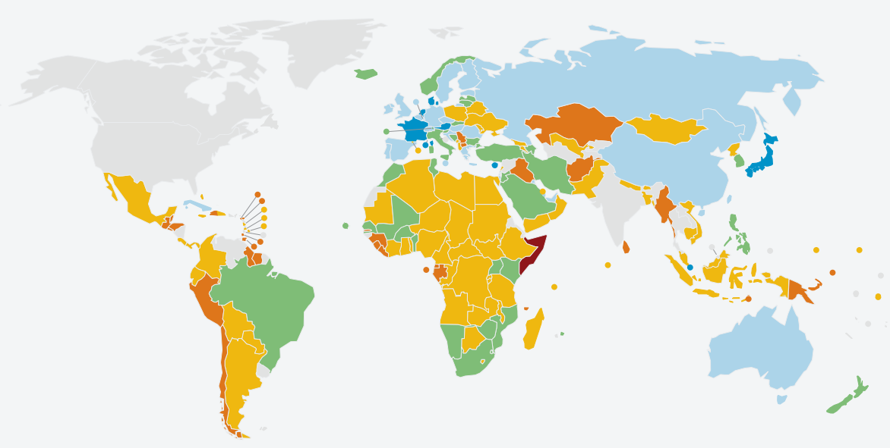
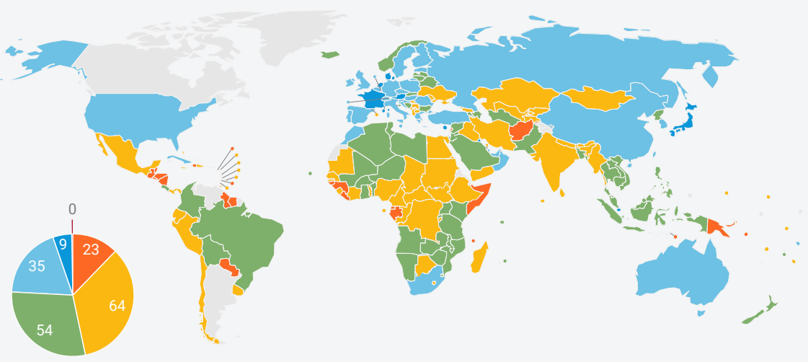
6.5.1 IWRM reporting to date (2017, 2020)
2017
186 countries reported on indicator 6.5.1 (2017, 2020).
87 countries low or medium-low IWRM implementation (in 2020)
= unlikely to reach 2030 target.
2020
Notes:
186 countries have reported on indicator 6.5.1 across 2017 and 2020.
In 2020, 87 countries still reported having low or medium-low implementation of IWRM overall, shown by the orange and yellow colours on this map, meaning they are unlikely to reach the global target by 2030 at the current rate of implementation.

Slide 36
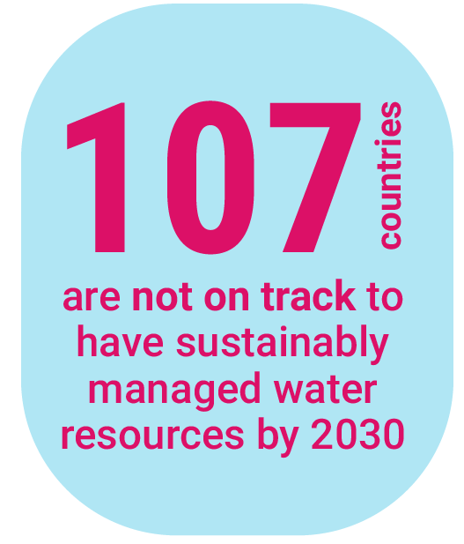
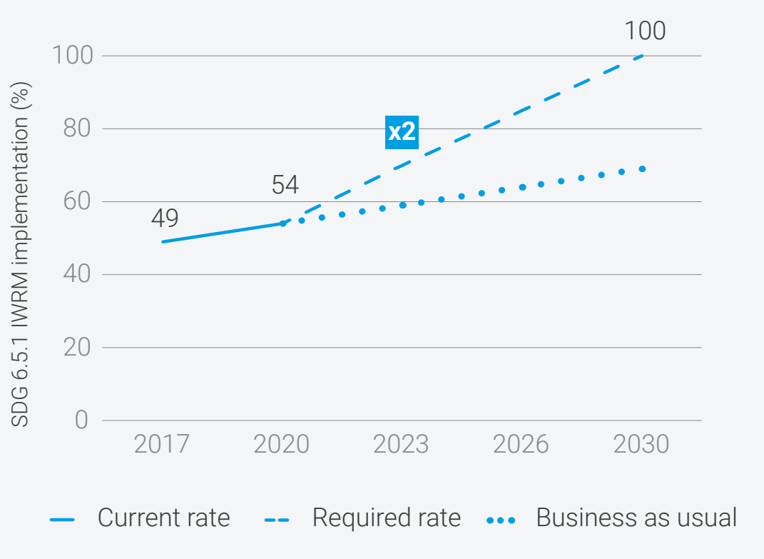

IWRM implementation needs to accelerate
Notes:
While the global average score increased from 49 in 2017 to 54 in 2020, the global rate of implementation of IWRM urgently needs to double.
{CLICK} Indeed, 107 countries are not on track to reach the global target by 2030.
In most of these countries, the rate of implementation will need to more than double. But this will be difficult, given other development challenges and priorities, and the relatively low levels of capacity that are likely in these countries.

Slide 37
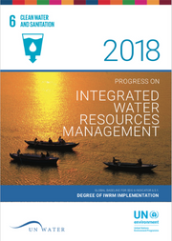
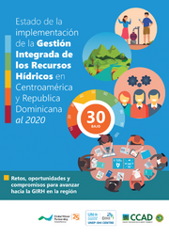
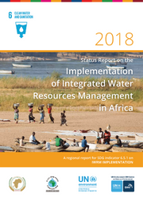
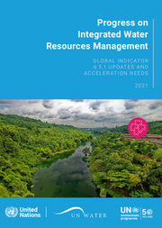
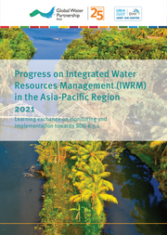
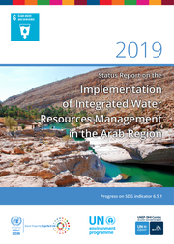
Global and Regional Reports
Notes:
You can read more about progress on IWRM implementation, as well as examples and suggestions for accelerating progress, {CLICK} in the various global and regional progress reports available on the IWRM Data Portal.
Regional reports are available for Central America, the Arab region, Africa, and Asia Pacific.

Slide 38
Recap: Useful links to resources
IWRM Data Portal
http://iwrmdataportal.unepdhi.org
SDG 6.5.1 Help Desk
iwrmsdg651@un.org
SDG 6 IWRM Support Programme
https://www.gwp.org/en/sdg6support/
Support Programme
sdg6iwrmsp@gwp.org

